Slide 1

Modern Data Management: Apple
Nicholas Cheung, Zuojun Gong, Yutong Li, Peter Weon

Slide 2
Agenda
Description
ER Diagram
Relational Schema
Interesting Queries
Modification & Insertion Statements

Slide 3
Description

Slide 4
Description
Target Company: Apple
User Group: Customer Service/Quality Control
Problem: Inability to identify the root cause of a product complaint may lead to high operation and maintenance cost
Solution: Connect all the departments in the supply chain in order to help trace the root source of product defects

Slide 5
ER Diagram

Slide 6
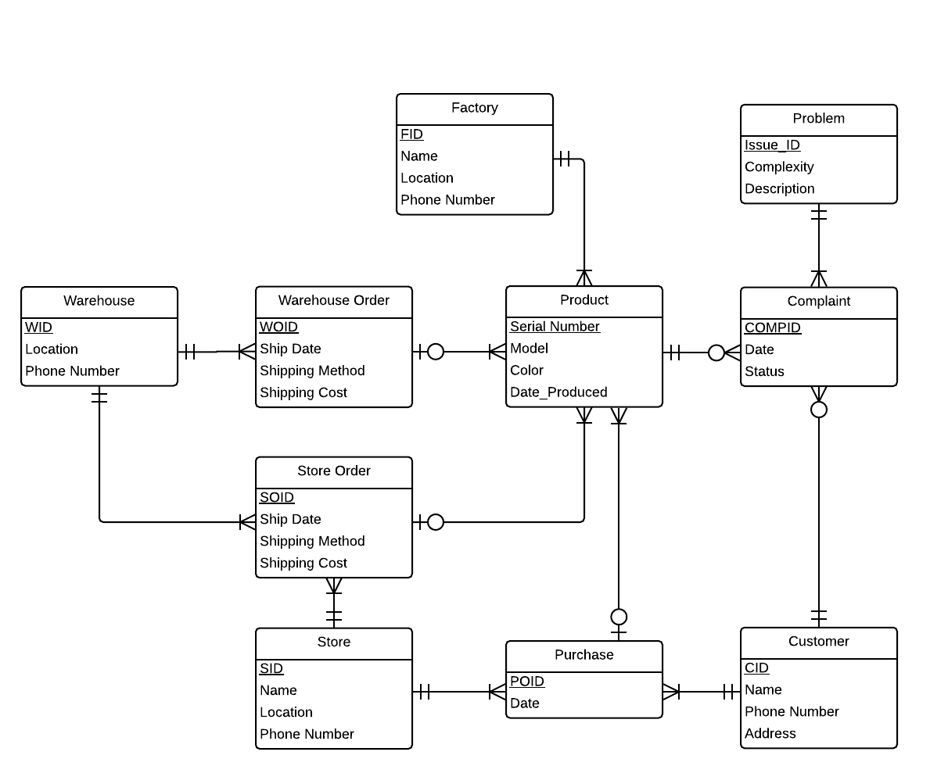
ER Diagram
Constraints:
Every complaint filed should only contain a specific problem for one particular product.
Products will only be purchased once by one customer at one store.
The company only uses one shipping carrier.
Every product is produced by only one factory
Clarifications:
Entries in the Product table refer to individual products, not product types

Slide 7
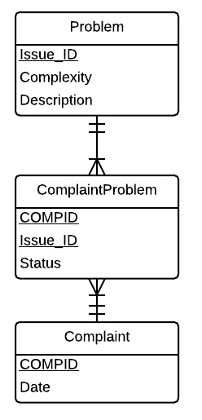
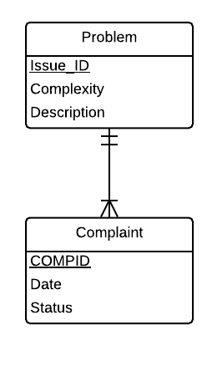
Alternative Assumptions
What if multiple problems are allowed in a complaint?

Slide 8
Relational Schema

Slide 9
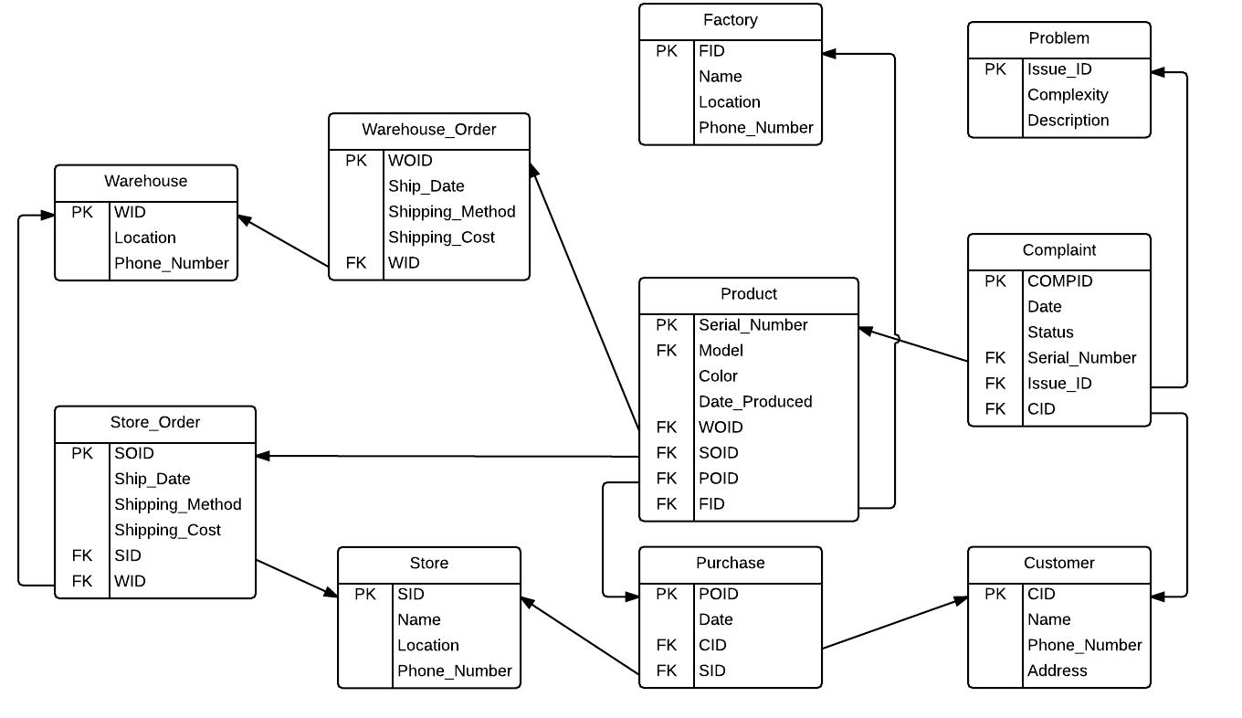
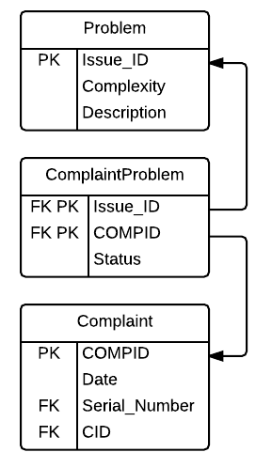
Relational Schema

Slide 10
Interesting Queries

Slide 11
Query A
Products bought by a specific customer
select serial_number,model,color,date_produced from customer join purchase on customer.cid=purchase.cid join product on product.poid=purchase.poid where customer.name='Nicholas'

Slide 12
Query B
Model with the most complaints
Select Model,count(CID) as Occurrence From Complaint C, Product P where C.Serial_Number = P.Serial_Number Group By Model

Slide 13
Query C
Complete information about a product
Select * From Product P Left Outer Join Factory F on P.FID = F.FID Left Outer Join Warehouse_Order WO on WO.WOID = P.WOID Left Outer Join Warehouse W on W.WID = WO.WID
Left Outer Join Store_Order SO on P.SOID = SO.SOID Left Outer Join Store S on SO.SID = S.SID Left Outer Join Purchase on Purchase.POID = P.POID Left Outer Join Customer C on Purchase.CID = C.CID where p.serial_number='00200004'

Slide 14
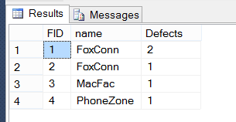
Query D
For every factory, number of defective products produced
select Factory.FID,Factory.name,count(distinct Product.Serial_Number)as Defects from Product join Complaint on Product.Serial_Number=Complaint.Serial_Number join Factory on Product.FID=Factory.FID group by Factory.FID,Factory.name

Slide 15
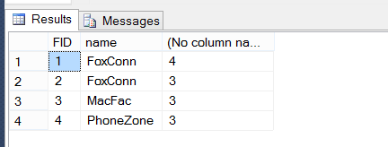
Query E
For every factory, number of all products produced
select Factory.FID,Factory.name, count(Serial_Number) from Product join Factory on Product.FID=Factory.FID group by Factory.FID,Factory.name

Slide 16
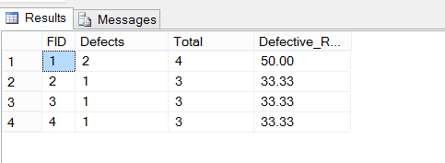
Query F
Defect rate for every factory
with alias as (Select F.FID, count(distinct P.Serial_Number) as Defects From Complaint, Product P, Factory F where Complaint.Serial_Number = P.Serial_Number and P.FID = F.FID Group By F.FID),
voila as (Select F.FID, count(*) as Total From Product P, Factory F where P.FID = F.FID Group by F.FID) Select alias.FID, Defects, Total, cast(round(100.0*Defects / Total,2) as numeric(10,2)) as Defective_Rate From alias, voila where alias.FID = voila.FID

Slide 17
Modification & Insertion Statements

Slide 18
Statements A & B
Create new warehouse order
insert into Warehouse_Order values (9, '15/05/2015', 'Cargo', 20, 2)
Update product after shipped to warehouse and store
UPDATE Product
SET WOID=8, SOID=8
WHERE Serial_Number='00200005'

Slide 19
Statement C
Cancel store order
UPDATE Product
SET SOID=NULL
WHERE Product.SOID=1
DELETE FROM Store_Order
WHERE SOID=1;

Slide 20
thank you.

